Slide 1

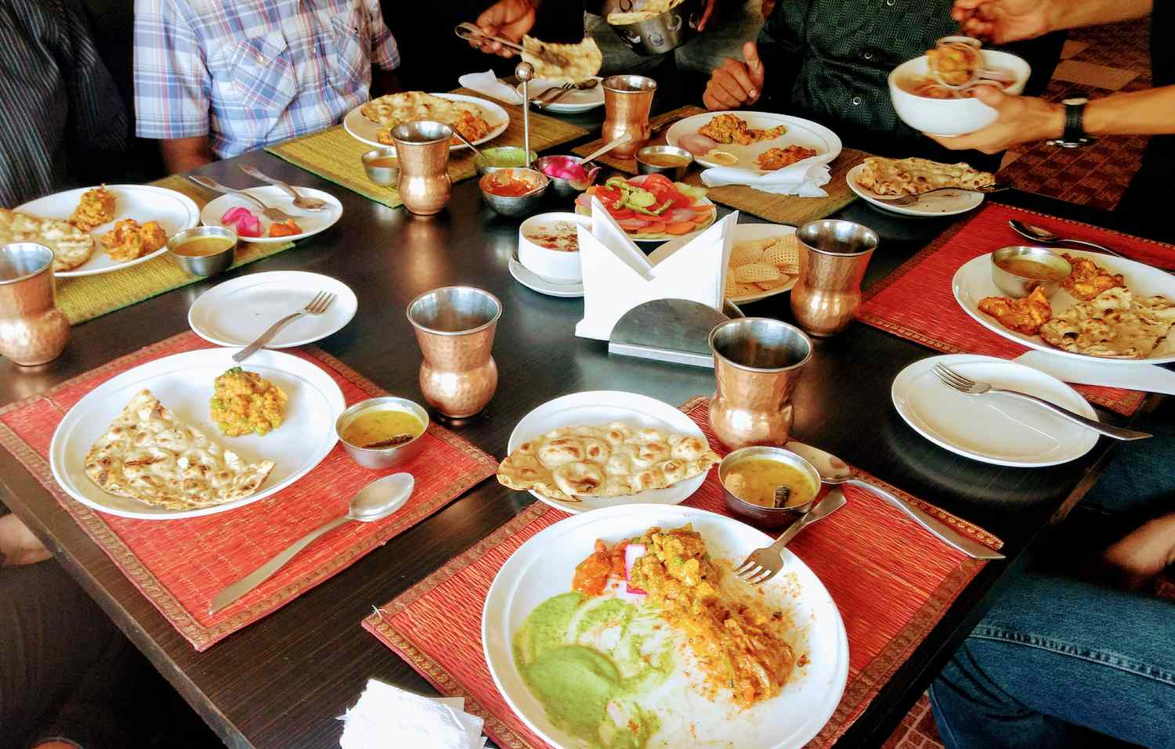
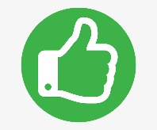
HTTP Status Codes
Imagine you're at a restaurant, and you order some food. Now, when your order is brought to you, it might come with different signals. For instance:
If your order arrives smoothly and everything is great, you get a thumbs-up or a smiley face. This is like an "HTTP 200 OK" status code. It means everything is fine with your request, and you're getting what you asked for.
Restaurant
Order Food
HTTP 200 OK

Slide 2
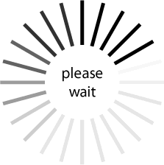
HTTP Status Codes
Now, if there's a little hiccup, like the kitchen is busy and your food might take a bit longer, you might get a polite "Please wait a moment." This is similar to an "HTTP 202 Accepted" status code. It means your request is received, but the server needs more time to process it.
Restaurant
Order Food
HTTP 202 Accepted

Slide 3
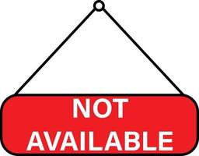
HTTP Status Codes
But if there's a bigger issue, like they ran out of what you ordered, you might get a "Sorry, that's not available right now." This is like an "HTTP 404 Not Found" status code. It means the server couldn't find what you were looking for.
Restaurant
Order Food
HTTP 404 Not Found

Slide 4
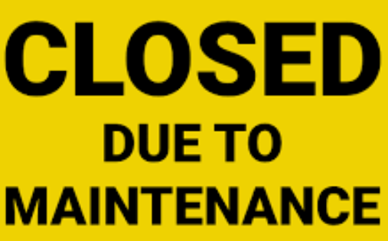
HTTP Status Codes
And if something goes really wrong, like the chef is sick and they can't make any food, you might get a "We're closed for maintenance." This is similar to an "HTTP 500 Internal Server Error" status code. It means there's a problem on the server's side, and they can't fulfill your request.
Restaurant
Order Food
HTTP 500 Internal Server Error

Slide 5
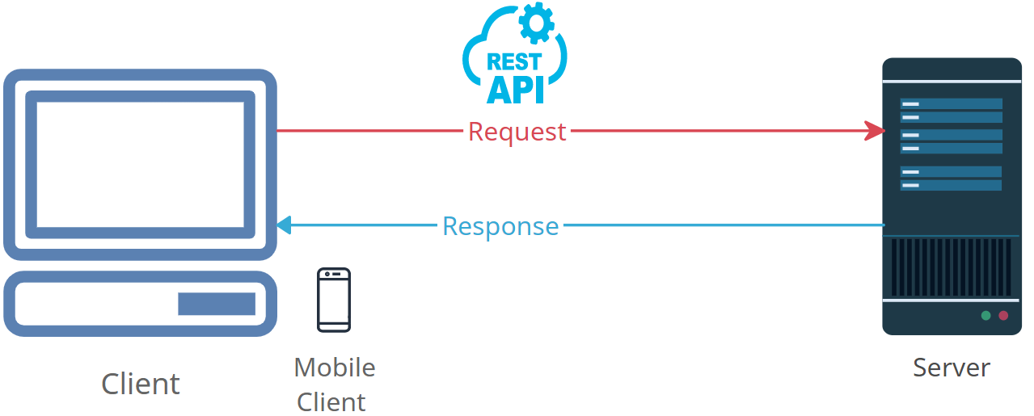
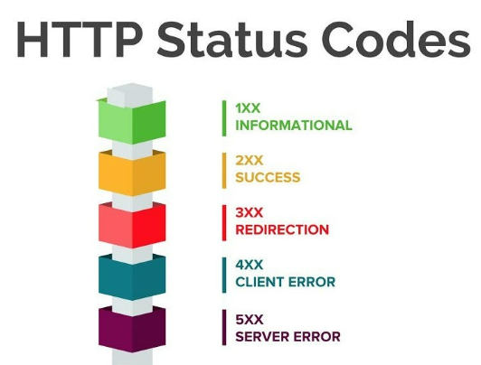
HTTP Status Codes
So, just like the signals you get when you order food, websites and servers use HTTP status codes to let your browser know how things are going when it requests information from the internet. It's a way of communication between your browser and the websites, making sure you get the right response, whether it's a thumbs-up or an explanation for any issues.

